Slide 1



Eclipse SDV Hackathon Chapter 4
OTA Outlaws: Doctor Whodunit - Every Fault Leaves Evidence
October 6-8 2026
COPYRIGHT (C) 2026, ECLIPSE FOUNDATION

Slide 2

Our Overall Goal
Create a Safety Evidence Chain to verify the Battery Thermal Guardian using…
  The Processes:
  -Functional Safety Engineering
  -Test Management
  The Eclipse SDV components:
  -KUKSA CAN-Provider
  -KUSA Data Broker
  -VSS/uProtocol Publisher
  -AZ3166 with ThreadX
  -DFM/OpenSOVD
  …to combine Eclipse SDV components with bullet proof engineering processes!
Copyright© Eclipse Foundation AISBL and contributors. Made available under CC-BY-SA 4.0 International.

Slide 3
Our Development Approach
Define Possible System Faults
Derive Hazardous Events
Specify Safety Goals
Derive Requirements
Implement Requirements in the Battery Thermal Guardian
Create Test Scenarios and inject them into the Campaign Runner
Copyright© Eclipse Foundation AISBL and contributors. Made available under CC-BY-SA 4.0 International.

Slide 4
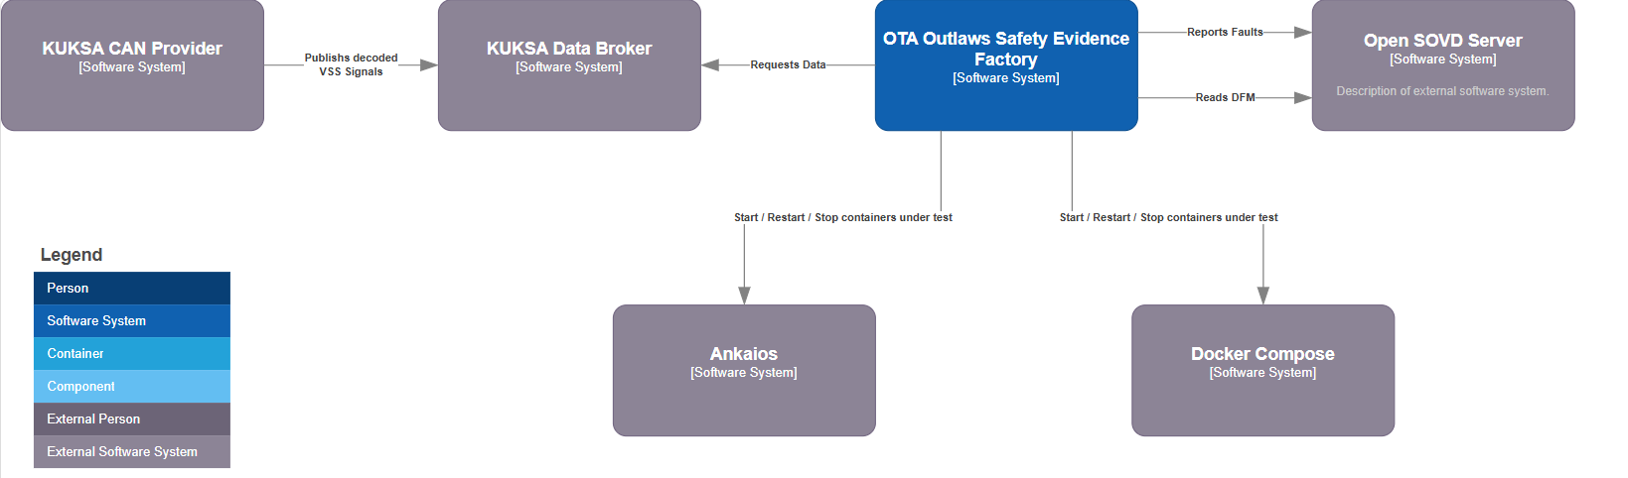
Our Systems Setup
Copyright© Eclipse Foundation AISBL and contributors. Made available under CC-BY-SA 4.0 International.

Slide 5
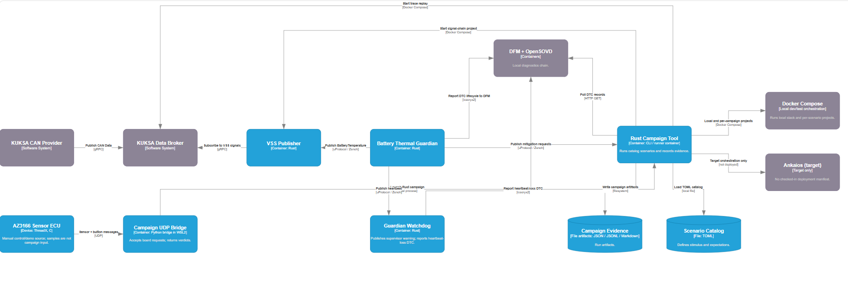
Our Technical Architecture
Copyright© Eclipse Foundation AISBL and contributors. Made available under CC-BY-SA 4.0 International.

Slide 6
Demo
Baseline run → nominal behavior confirmed
Transport fault → e.g., delayed message, measurable detection
Signal fault → e.g., stuck value, state transition triggered
Diagnostics correlation → DFM record ↔ OpenSOVD exposure
Remote rerun → same scenario via remote framework, consistent verdict
Verdict report → clear PASS / FAIL / INCONCLUSIVE with evidence links
Copyright© Eclipse Foundation AISBL and contributors. Made available under CC-BY-SA 4.0 International.

Slide 7
What makes our project and our solution special
We have a full traceability from Safety Analysis over Requirements to Test Scenarios: → It is ensured that our solution works as expected
We have complete campaign runner UI creating test evidence reports
We have a S-BOM which helps tracking on bugs, security gaps, and copy left licenses
Copyright© Eclipse Foundation AISBL and contributors. Made available under CC-BY-SA 4.0 International.

Slide 8
Thank You
Thanks Hack Coach and Eclipse SDV!
October 6-8 2026
COPYRIGHT (C) 2026, ECLIPSE FOUNDATION

